Slide 1
Lecture 7 CUDA Shared Memory
Kyu Ho Park
Mar. 28, 2017

Slide 2
CUDA Memory Architecture
Grid
Block 0
Block 1
공유메모리
(Shared Memory)
공유메모리
(Shared Memory)
Register
Register
Register
Register
Thread 0
Thread 1
Thread 0
Thread 1
Host
Global Memory
Constant Memory
Texture Memory

Slide 3
Shared Memory
On-board memory: Global Memory
On-chip memory: Shared memory which is smaller, faster than global memory.
each SM contains a small low-latency memory pool shared by all threads in the thread block currently executing on that SM
shared memory address space is shared by all threads in a thread block. Its contents have the same lifetime as the thread block in which it was created
The bandwidth degradation is caused by misaligned access and noncoalesced accesses of global memory.
-misaligned access: could be improved by L1 cache,
-noncoalesced access: could be improved by shared memory.
Each SM has 64KBytes of on-chip memory which are shared by the Shared memory and L1 cache.

Slide 4
Shared memory
Shared memory:
An intra-block(block 내의) thread communication channel
A program-managed cache for global memory data (can be configured by program)
Scratch pad(small) memory for transforming data to improve global memory access patterns.
Each SM has a shared memory which is 20~30 times faster than Global Memory.
The shared memory address space is shared by all threads in a thread block.
Shared memory accesses are issued per warp.
Each request to access shared by a warp is serviced in one transaction. (individual)

Slide 5
Transaction
Transaction processing: a processing that is divided into individual, indivisible operations.
Transaction processing:
BEGIN_TRANACTION
reserve Seoul-Tokyo;
reserve Tokyo-Rio;
reserve Rio-Bouenos;
END_TRANSACTION
BEGIN_TRANACTION
reserve Seoul-Tokyo;
reserve Tokyo-Rio;
reserve Rio-Bouenos: NotAvailable;
=> ABORT_TRANSACTION;

Slide 6
Shared Memory Allocation
1. Statically (1D,2D,3D)
If declared inside a kernel,
__shared__ float A[i][j];
the scope of A is local to the kernel.
If declared outside of any kernel, the scope of the variable is global to all kernels, or
extern __shared__ float B[i];
2. Dynamically (1D)
extern __shared__ int tile[]; Because the size of this array is unknown at compile-time, you need to dynamically allocate shared memory at each kernel invocation by specifying the desired size in bytes as a third argument inside the triple angled brackets, as follows: kernel<<<grid, block, isize * sizeof(int)>>>(...)

Slide 7
CUDA Thread-block-grid
1 block can have max. 1024 threads.
SM executes threads in a multiple of 32 threads.
__global__ void kernel<<<Dg,Db,Ns,S>>>();
Dg : dimension of the grid , type dim3.
Db : dimension of the block, type dim3.
Ns : number of bytes of shared memory which are dynamically allocated/block, type size_t.
S: Associated cudaStream_t. ‘S=0 ‘ means synchronous.

Slide 8
thread-block dimensions
dim3 Dg(3,2,1);//(x,y,z)
dim3 Db(4,2,1);//(x,y,z)
kernelFunction <<<Dg, Db>>> (a,b,c);
Grid
Block

Slide 9
Banks of Shared Memory
Bank: the shared memory is divided into 32(=warp size) equal sized memory and they are called banks.
Bank Conflict: When multiple threads in a warp request the same bank in a shared memory. (serial access)
Memory Access Mode:
-Parallel access: multiple addresses accessed across multiple banks
-Serial access: When multiple addresses accessed within the same bank, the request must be serialized.
-Broadcast access: All threads in a warp read the same address within a single bank. One memory access transaction is executed and the accessed word is broadcast to all requesting threads. bandwidth utilization is poor because only a small number of bytes are read.

Slide 10
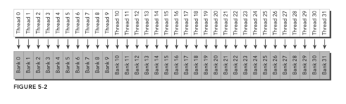
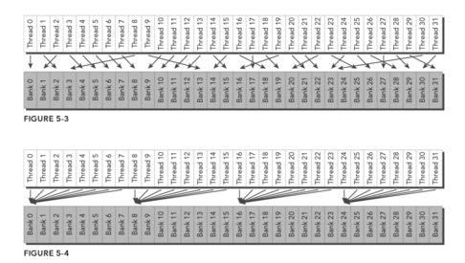
Access Patters of Shared Memory
Optimal parallel access pattern
: no bank conflict
Random access pattern
: no bank conflict
Several threads access the same bank
conflict-free broadcast access
Bank conflict
from [PCCP]

Slide 11
Access Mode
Bank width:
-4 bytes for devices of compute capability 2.x,
-8 bytes for devices of compute capability 3.x.
Bank index:
bank index=(byte address/(4bytes or 8 bytes))%32
Bank conflict does not occur when two threads from the same warp access the same address
for read accesses, the word is broadcast to the requesting threads, and for write accesses, the word is written by only one of the threads — which thread performs the write is undefned

Slide 12
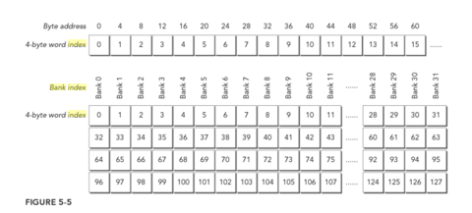
Word index and Bank Index Fermi
The bank width is 32 bits and there are 32 banks
Each bank has a bandwidth of 32bits per two clock cycles.
bank index=(byte address/(4bytes))%32
from [PCCP]

Slide 13
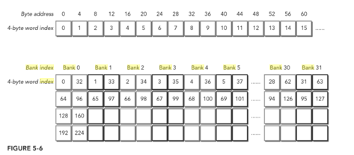
Bank index for 32-bit mode of Kepler
In Kepler device, shared memory has 32 banks with the two address mode: 32-bit mode and 64-bit mode.
1. 64bit mode
successive 64-bit words map to successive banks. Each bank has a bandwidth of 64 bits per clock cycle. bank index = (byte address ÷ 8 bytes/bank) % 32 banks
2. 32bit mode
Though word 0 and word 32 are both in bank 0, reading both in the same memory request would not imply a bank conﬂict. Cause its bandwidth is 64bits

Slide 14
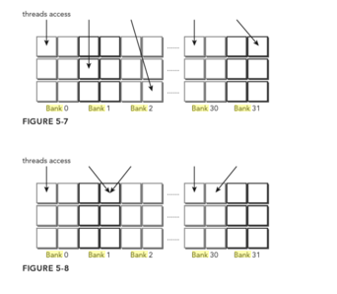
Bank Conflict Free Case in 64bit mode
두 thread가 같은 bank address에 접근할 경우
bank conflict이 아니다
2.64 bit mode에서 bank30과 같이 접근을 할 경우
Bank conflict가 발생하지 않는다. 왜냐하면,
Bank bandwidth가 64bit이기 때문에 처리 가능하다.
from [PCCP]

Slide 15
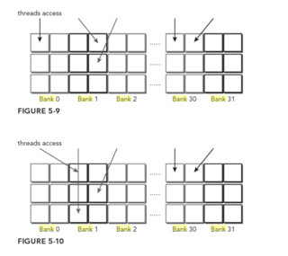
Bank Conflict Cases
2 way conflict
bank conflict가 아니다.
3 way conflict
bank conflict가 아니다.

Slide 16
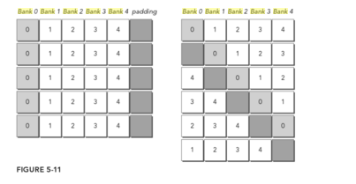
Memory Padding
memory padding을 추가해서 bank conflict가 발생하지 않게 한다.
0으로 표시된 address을 access을 동시에 access할려면 bank conflict가 발생한다.
from [PCCP]

Slide 17
Access Mode Configuration
cudaError_t cudaDeviceGetSharedMemConfig(cudaSharedMemConfig *pConfig);
/* The result is returned in pConfig.
The bank configuration is one of the following (in kepler device, there are two mode 4-byte and 8-byte)
cudaSharedMemBankSizeFourByte,
cudaSharedMemBankSizeEightByte. */
To set a new bank size:
cudaError_t cudaDeviceSetSharedMemConfig(cudaSharedMemConfig config);
/* The supported bank configurations:
cudaSharedMemBankSizeDefault,
cudaSharedMemBankSizeFourByte,
cudaSharedMemBankSizeEightByte */

Slide 18
Configuring the Amount of Shared Memory
Each SM has 64KBytes of on-chip memory which are shared by the Shared memory and L1 cache.
Per-device configuration:
cudaError_t cudaDeviceSetCacheConfig(cudaFuncCache cacheConfig);
Per-kernel configuration:
cudaError_t cudaFuncSetCacheConfig(const void* func, enum cudaFuncCacheca cheConfig);

Slide 19
Synchronization
Barrier synchronization
system-level : Wait for all work on both the host and the device to complete
block the host application until all CUDA operations (copies, kernels, and so on) have completed: cudaError_t cudaDeviceSynchronize(void)
block-level : Wait for all threads in a thread block to reach the same point in execution on the device.
_device__ void __syncthreads(void); When __syncthreads is called, each thread in the same thread block must wait until all other threads in that thread block have reached this synchronization point. All global and shared memory accesses made by all threads prior to this barrier will be visible to all other threads in the threadblock after the barrier.
The function is used to coordinate communication between threads in the same block, but it can negatively affect performance by forcing warps to become idle

Slide 20
Synchronization
intra-block synchronization
1. Barrier: All calling threads wait for all other calling threads to reach the barrier points.
2. Memory fence: All calling threads stall until all modifications to memory are visible to all other calling threads.

Slide 21
Weakly-Ordered Memory Model
The order of writing data to memory is not necessarily the same order of those accesses in the source codes.
The order of reading data from different memories is not necessarily the order of each read instruction in the program if instructions are independent each other.

Slide 22
Explicit Barrier
It is possible to perform a barrier among threads in the same thread block.
void __syncthreads( );
/* it acts as a barrier point at which threads in a block must wait until all threads have reached that point.
__syncthreads also ensures that all global and shared memory accesses made by these threads prior to the barrier point are visible to all threads in the same block

Slide 23
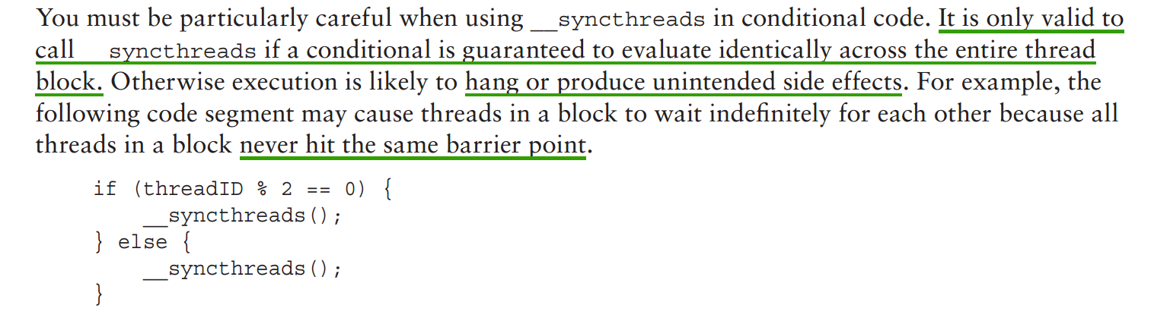
Explicit Barrier

Slide 24
Memory Fence
It ensures that any memory write before the fence is visible to other threads after the fence.
Recall that memory fences do not perform any thread synchronization, and so it is not necessary for all threads in a block to actually execute this instruction.
There are three memory fences depending on
the scope:
-block: void __threadfence_block();
ensures that all writes to shared memory and global memory made by a calling thread before the fence are visible to other threads in the same block after the fence
-grid : void __threadfence( );
// stalls the calling thread until all of its writes to global memory are visible to all threads in the same grid
-system( host and device):
void __threadfence_system( );//this one stalls the calling thread to ensure all its writes to global memory, page-locked host memory, and the memory of other devices are visible to all threads in all devices and host threads.

Slide 25
Volatile qualifier
Declaring a variable in global or shared memory using the volatile qualifier prevents compiler optimization which might temporally cache data in registers or local memory. any reference to this variable is compiled to a global memory read or global memory write instruction that skips the cache.

Slide 26
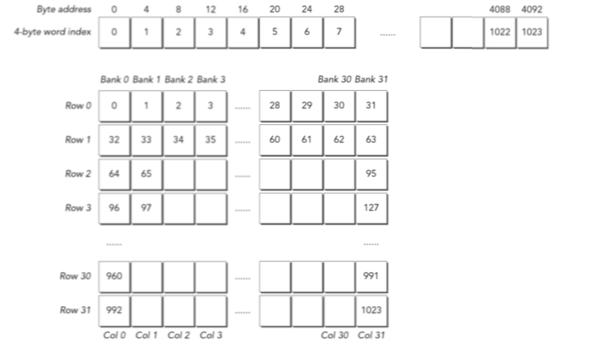
Data Layout of Shared Memory Square Shared Memory
1D data layout
32x32 2D shared memoy layout(logical)
from [PCCP]

Slide 27
Square shared memory
2D shared memory variable is declared statically as follows:
__shared__ int tile[N][N];
Two ways to access the tile:
tile[threadIdx.x][threadIdx.y]
tile[threadIdx.y][threadIdx.x]
Which is better?

Slide 28
The best case is that threads in the same warp access separate banks.
Threads in the same warp can be identified by consecutive values of threadIdx.x.
tile[threadIdx.y][threadIdx.x] will show better performance and fewer bank conflicts than tile[threadIdx.x][threadIdx.y].

Slide 29
Accessing Row-Major /Column-Major
block(3,2,1)
0 (0,0) | 1 (1,0) | 2 (2,0)
3 (0,1) | 4 (1,1) | 5 (2,1)
Row-Major no bank conflict
Column-Major
address | thread
0 | 0
1 | 1
2 | 2
3 | 3
4 | 4
5 | 5
address | thread
0 | 0
1 | 3
2 | 1
3 | 4
4 | 2
5 | 5

Slide 30
A grid with 2D block 32 x 32:
#define BDIMX 32
#define BDIMY 32
dim3 block( BDIMX, BDIMY);
dim3 grid(1,1);
Kernel operations:
write global thread indices to a 2D shared memory
array in row-major order.
read those values from shared memory in row-major order and store them to global memory.

Slide 31
Row-Major Access
<Free of bank conflict>
__global__ void setRowReadRow(int *out){
__shared__ int tile[BDIMY][BDIMX];
unsigned int idx=threadIdx.y*blockDimx.x+threadIdx.x;
tile[threadIdx.y][threadIdx.x]=idx;
__syncthreads();
out[idx]=tile[threadIdx.y][threadIdx.x];
}

Slide 32
Column-Major Access
<32-way bank conflict for a fermi device, 16-way bank conflict for a kepler device>
__global__ void setColReadCol(int *out){
__shared__ int tile[BDIMX][BDIMY];
unsigned int Idx=threadIdx.y*blockDim.x + threadIdx.x;
tile[threadIdx.x][threadIdx.y]=idx;
__syncthreads( );
out[idx]=tile[threadIdx.x][threadIdx.y];
}

Slide 33
Writing Row-Major and Reading Column-Major
__global__ void setRowReadCol(int *out){
__shared__ int tile[BDIMY][BDIMX];
unsigned int idx=threadIdx.y*blockDim.x+threadIdx.x;
tile[threadIdx.y][threadIdx.x]=idx;
__syncthreads();
out[idx]=tile[threadIdx.x][threadIdx.y];
}

Slide 34
Writing Row-Major, Reading Column-Major
Bank0 Bank1 Bank2 Bank3
 |  | (ix,iy)
 | (iy,ix)
Read from(ix,iy)
Write to (iy,ix)
blockDim.x
-------------------------------------------------------->

Slide 35
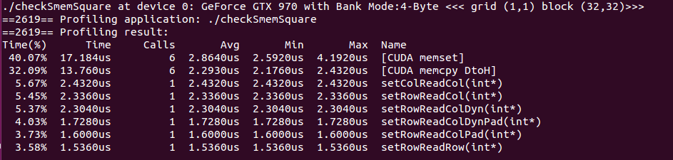

Slide 36
Dynamic Shared Memory
__global__ void setRowReadColDyn(int *out){
extern __shared__ int tile[];
//mapping from thread index to global memory index
unsigned int row_idx=threadIdx.y*blockDim.x + threadIdx.x;
unsigned int col_idx=threadIdx.x*blockDim.y + threadIdx.y;
//shared memory store operation
tile[row_idx]=row_idx;
__syncthreads();
//shared memory load operation
out[row_idx]=tile[col_idx];
}

Slide 37
Padding Statically Declared Shared Memory
__global__ void setRowReadColPad(int *out) {
__shared__ int tile[BDIMY][BDIMX+IPAD];
//mapping from thread index to global memory offset
unsigned int idx=threadIdx.y*blockDim.x + threadIdx.x;
//shared memory store operation
tile[threadIdx.y][threadIdx.x]=idx;
syncthreads();
out[idx]=tile[threadIdx.x][threadIdx.y];
}

Slide 38
CUDA Memory Architecture
Grid
Block 0
Block 1
공유메모리
(Shared Memory)
공유메모리
(Shared Memory)
Register
Register
Register
Register
Thread 0
Thread 1
Thread 0
Thread 1
Host
Global Memory
Constant Memory
Texture Memory

Slide 39
Constant Memory
Constant Memory: A read-only special purpose memory accessible uniformly by threads in a warp.
It is read-only for kernels, the host can read and write it.
It is in device DRAM and has a dedicated on-chip cache whose size is 64KB per SM.
It is best if all threads in a warp access the same location in constant memory. Accesses to different addresses by threads within a warp are serialized.
Constant memory variable qualifier: It must be declared in global scope. It can be accessible from all threads within a grid and from the host through runtime functions.
__constant__

Slide 40
constant memory variable initialization
cudaError_t cudaMemcpyToSymbol(const void *symbol, const void *src, size_t count, size_t offset, cudaMemcpyKind kind)
//copy the data pointed to by src to the constant memory location specified bt symbol on the device.

Slide 41
constant memory example
P(x)=a₀+a₁x+a₂x²+a₃x³+a₄x⁴
The coefficient a₀~a₄ are the same for all threads and never modified. These coefficients are excellent candidates for constant memory.

Slide 42
Warp shuffle Instruction
The shuffle instruction was introduced for the architecture whose computer capability is 3.0 or higher such as Kepler, Maxwell families to allow threads to directly read another thread’s register as long as both threads are in the same warp.
The shuffle instruction therefore offers a way to interchange data among threads in a warp.
The shufﬂe instruction has lower latency than shared memory and does not consume extra memory to perform a data exchange

Slide 43
lane in a warp
A lane : it simply refers to a single thread within a warp. A lane in a warp is identified by a lane index in the range [0,31].
In a 1D thread block, the laneID and warpID are obtained by the following realtions:
laneID=threadIdx.x%32,
warpID=threadIdx.x/32

Slide 44
Warp Shuffle Instructions
Two sets of shuffle instructions: one for integer variables and one for float variables.
int __shfl(int var, int scrLane, int width=warpSize);
If every thread in a warp execute the following instruction:
int y = __shfl(x,5,16);
//thread0~thread15 get the value x from the thread 5 (y를 통해서) and thread16~thread31 get the value from the thread21 (y를 통해서).

Slide 45
int __shfl_up(), __shfl_down(), __shfl_xor
int __shfl_up(int var, unsigned int delta, int width=warpSize);
__shfl_up(val,2); //shift the value to the right two lane
int __shfl_xor(int var, int laneMask, int width=warpSize);
/*It calculates a source lane index by performing a bitwise XOR of the caller’s lane index with lane mask.
__shfl_xor(val,1); this instruction results in a butterfly exchange.

Slide 46
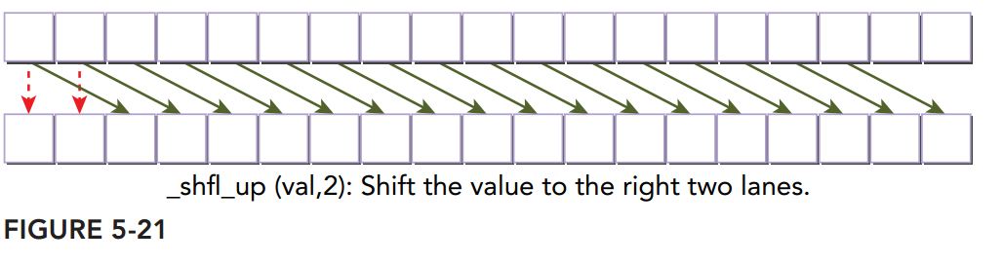
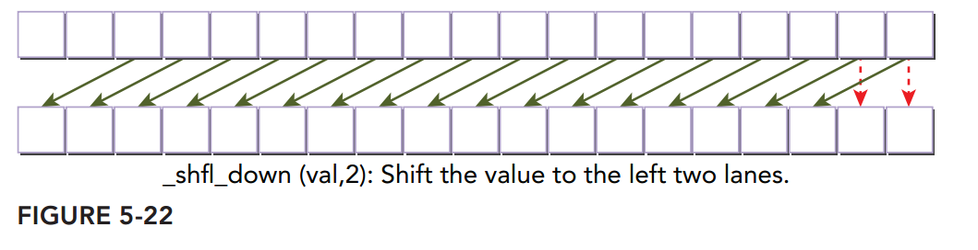
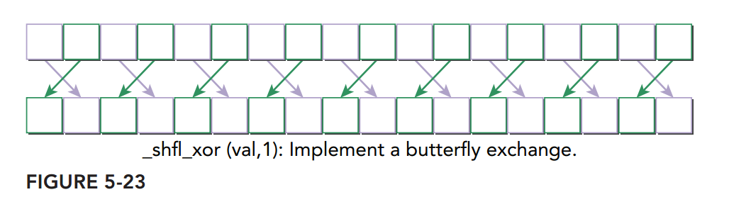
int __shfl_up(), __shfl_down(), __shfl_xor

Slide 47
examples of using the warp shuffling
Shuffle instruction can be applied to the three integer variable types:
Scalar variable,
Array,
Vector-typed variable.

Slide 48
Homework#3( Due: April 13 )
The square matrices A,B and C have following relation:
C=A x B, where the column size is NY and row size is NX( in his case NX=NY).
The matrix multiplication in C is given below:
void matricMul( int *A, int *B, int *C, int size){
for(int col=0; col <size; col++){
for(int row=0; row <size; row++){
int outidx=col*size +row;
for( int idx=0; idx < size; idx++){
C[outidx] +=A[col*size+idx]*B[idx*size+row];}
}
}
}
Remark: A,B,C are square matrices represented in 1D row-major linear address memory.

Slide 49
Matrix Multilication
Problem 1:
Make your CUDA program that uses only global memory on 2D grid and 2D blocks where:
int nx=15000;
int ny=15000;
int dimx=32;
int dimy=32;
dim3 block(dimx,dimy); //block dimension (32,32)
dim3 grid((nx + block.x-1)/block.x, (ny+block.y-1)/block.y);
Generate the matrix A and B treating them as linerar array:
//Data input
for( int i = 0; i < size; i++){
A[i] = i %1000; //input
B[i] = i %1000; // input
C[i] = 0;//output }

Slide 50
Matrix Multiplication
Problem 2: Find out optimal block and grid size. Explain the reason.
Problem 3: Make your CUDA program with global and shared memory.
Compare and analyze your result with Problem 2.
Problem 4: Make your program of the Problem 3 removing all explicit memory copies between the host and the device and use the unified memory. Refer to the source code ‘sumMatrixGPUMaanaged.cu’ at Chap.4.
Explain the advantages and disadvantages of the usage of the unified memory
*At the host program, you have to implement the matrix multiplication code in C and compare the result from the device. If the result is same, your CUDA program is correct. You have to show the captured screen at your report.
* Use visual profiler as much as possible to show your result.

Slide 51
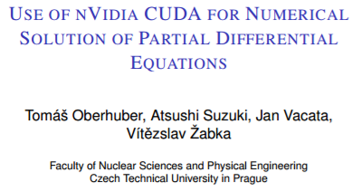
Presentation Schedule on April 13
Mr. 한승열
Mr. 김영석
“CUDA-Accelerated Monte-Carlo for HPC
,Andrew Sheppard “
SC11, Seattle, WA 12-18 November 2011 .

